Slide 1
Art Virtual Learning
High School Advanced Photography
Small Subject
Big Vision Project
April 30, 2020

Slide 2
High School Advanced Photography
Lesson: Miniatures
April 30
Objective/Learning Target:
To be more visually creative in seeing your world differently from a varied point of view, to experiment visually with items around you to create a photographic composition with a small object to give the appearance of a big world. Continued practice with magazine cut outs

Slide 3
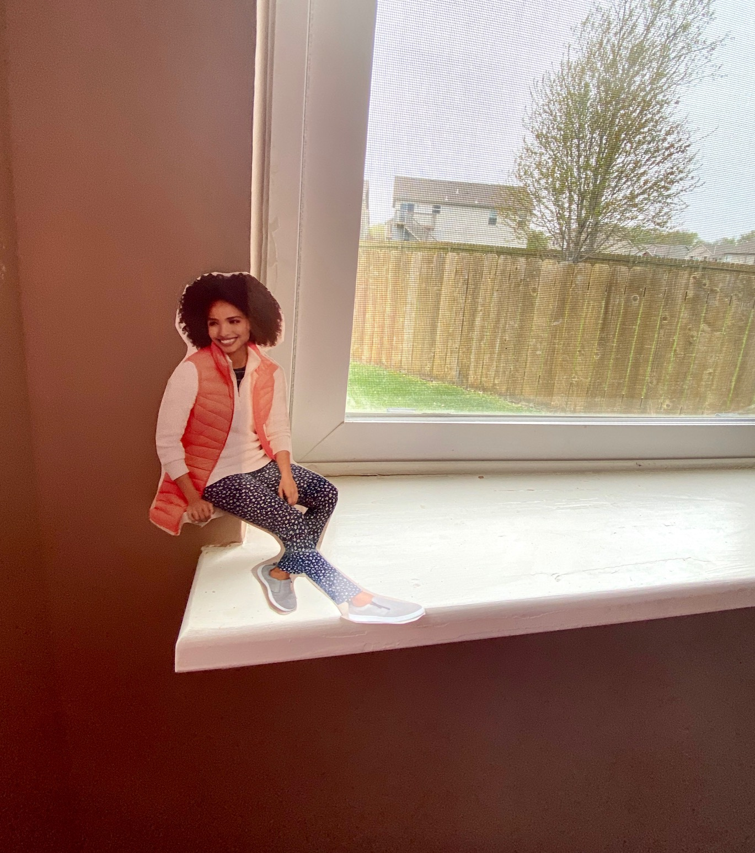
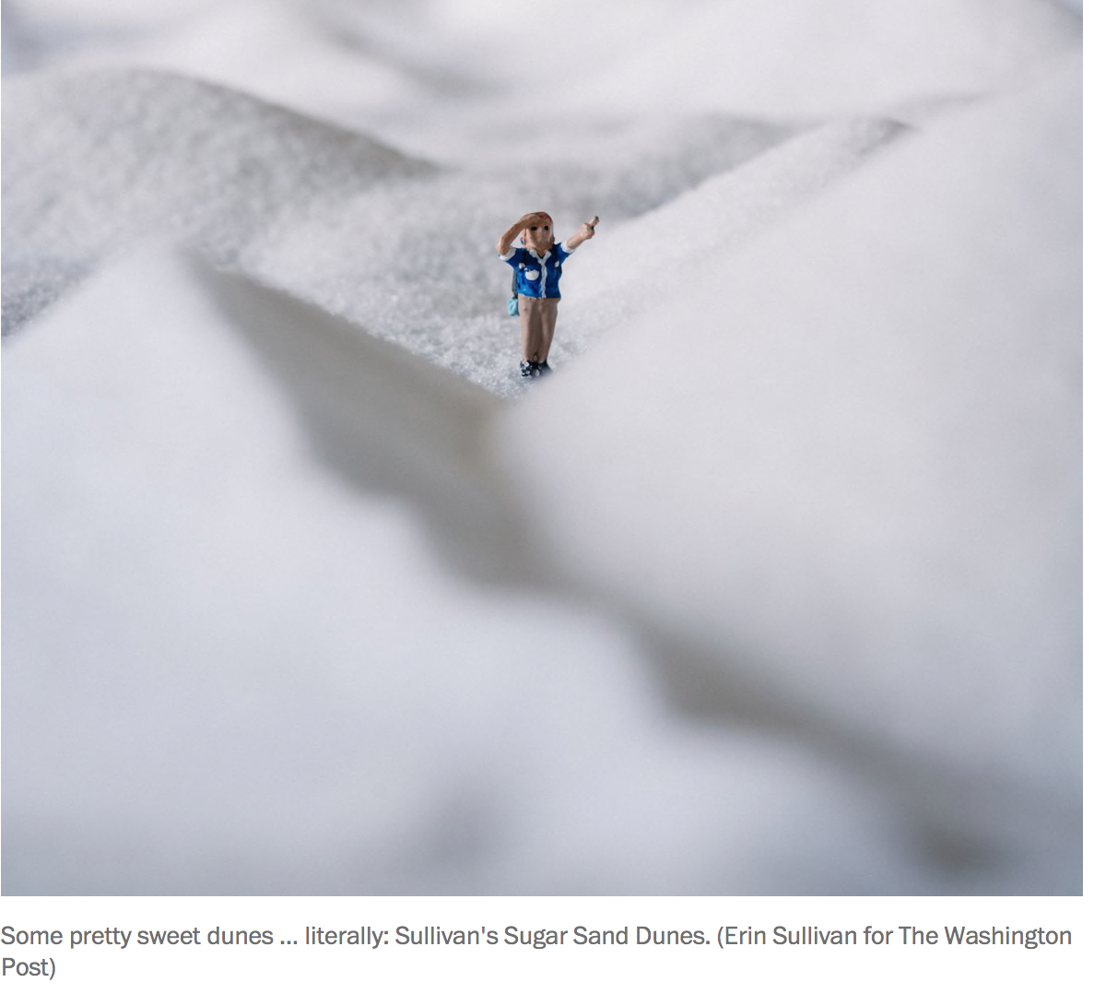
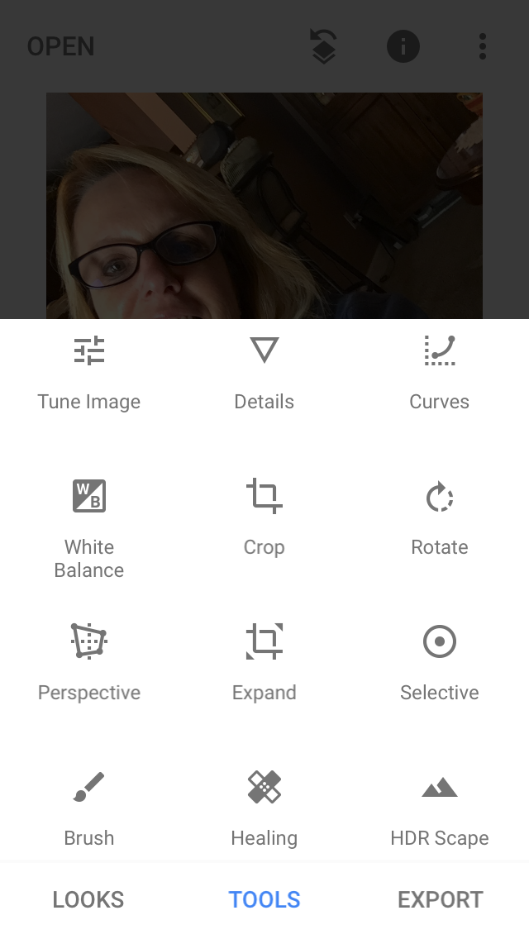
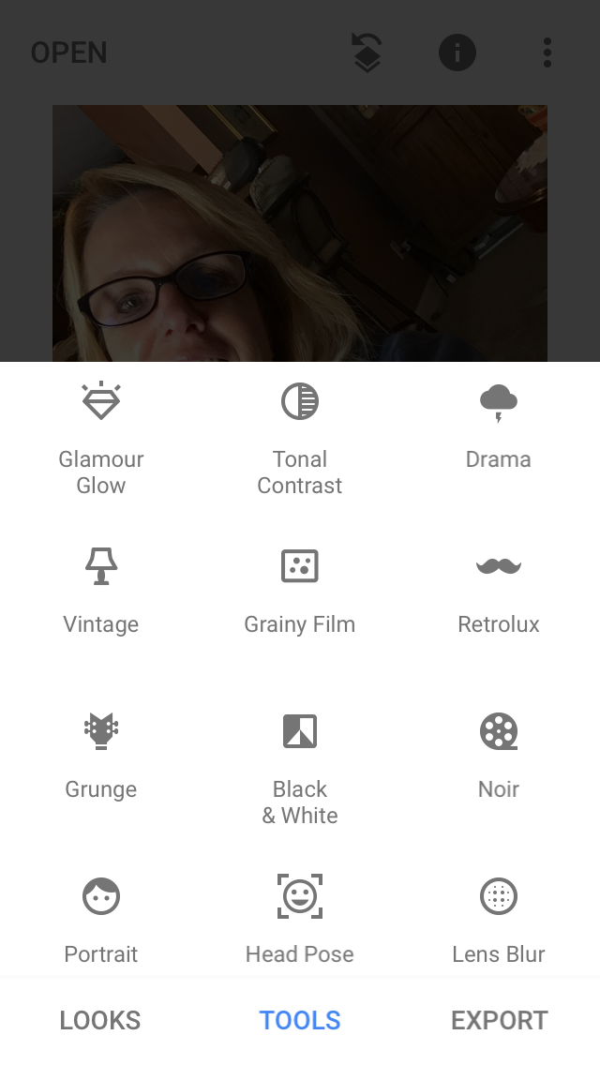
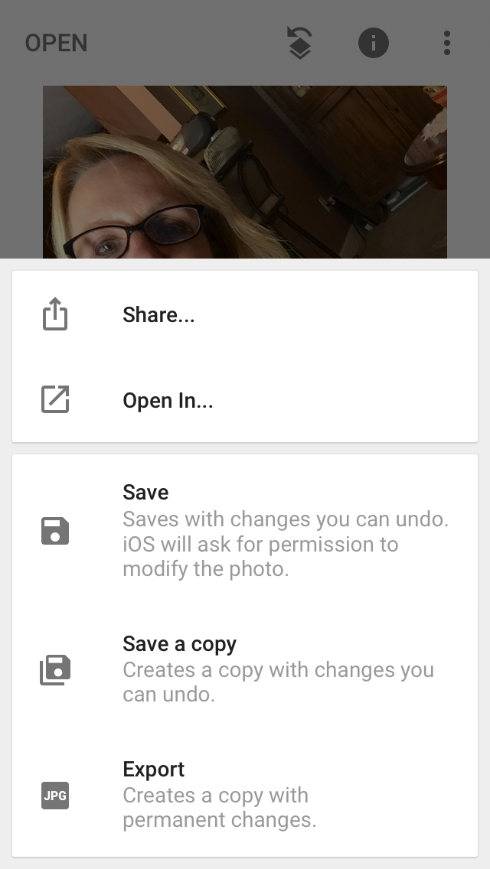
Scale and perspective mix up for amusement:
Day 4 “Small subject, big vision concept”
Continued practice with different subject matter.
Bell Ringer: How about cutting our magazine
Pics? Do you have any?
Remember: Miniature Photography is simply one form of photographic artistry to mix the real with the surreal. Rather than simply building a scale model diorama portraying some kind of scene, the idea is to integrate true-scale, real-world objects, foods or 'entities' into the miniature world
Task #1: Start experimenting with arranging a different subject matter (small toy, miniature, cut out from magazine) with items around your home.
50 mini ideas video. “50 Cool Miniature Photography Ideas”
What objects around the house did you see in the YouTube video? I saw a carrot and whistle as just a few.
Task #2: Take several photos of your set up from different points of view with another subject matter.
Task #3: Which point of view works best for you? Edit that photo on your phone using the default edit on phone or try a new APP such as Snapseed.
Scene above ^ was created with sugar.
Snapseed features:

Slide 4
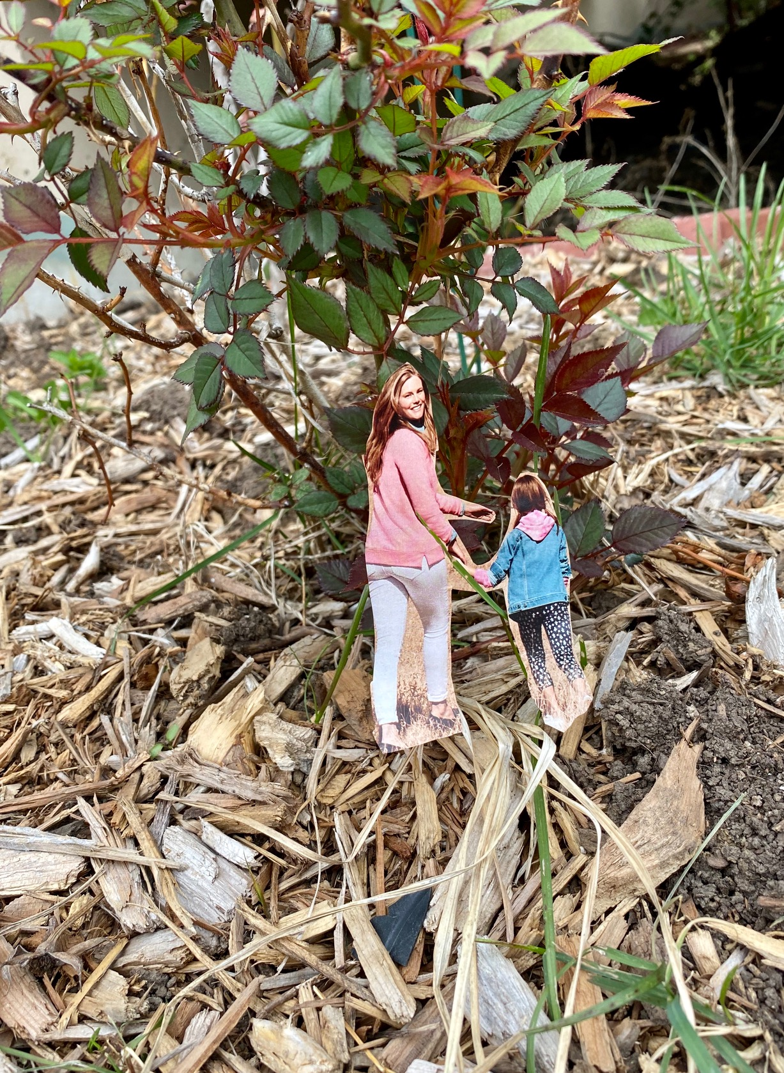
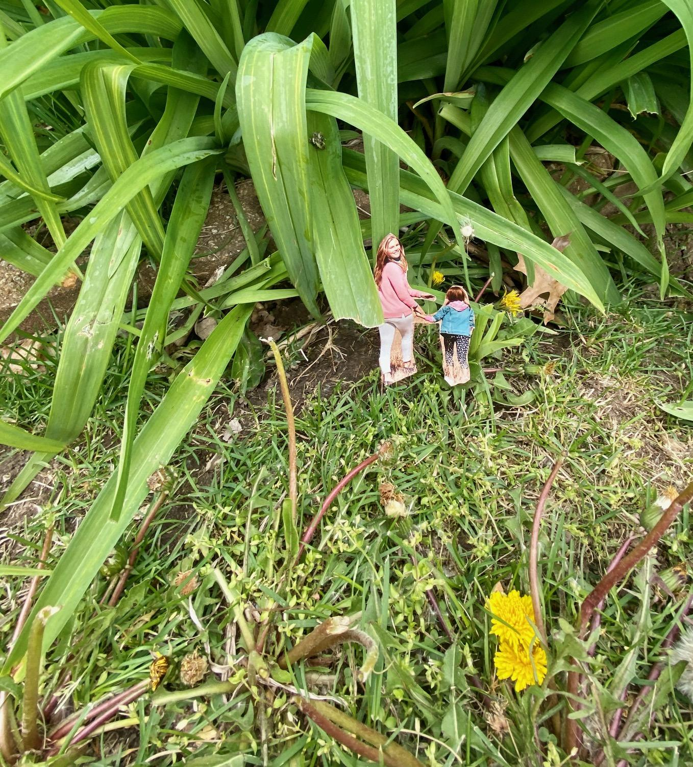
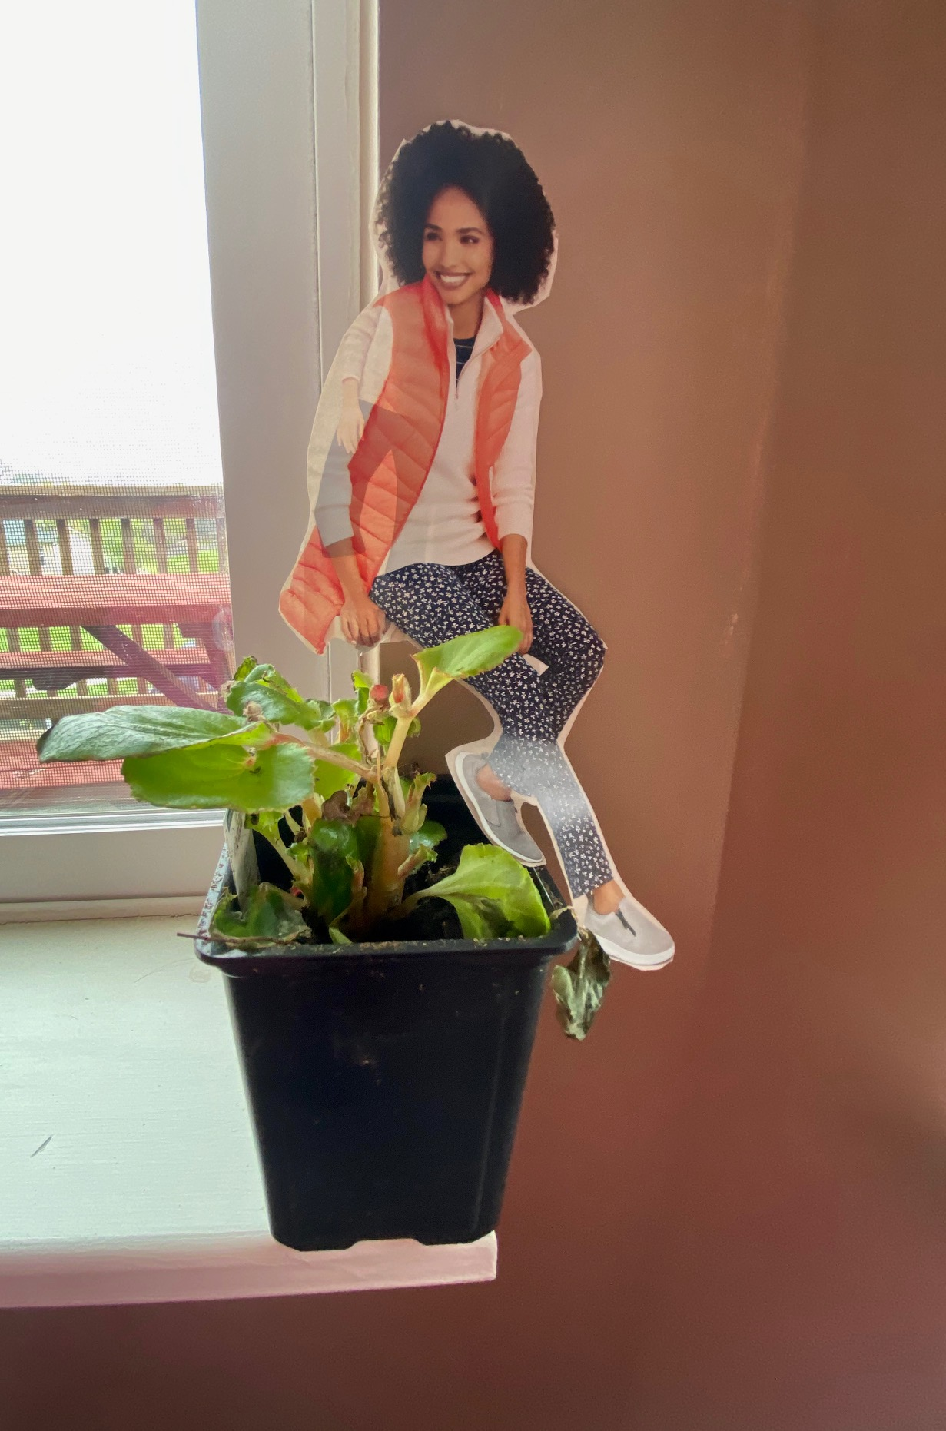
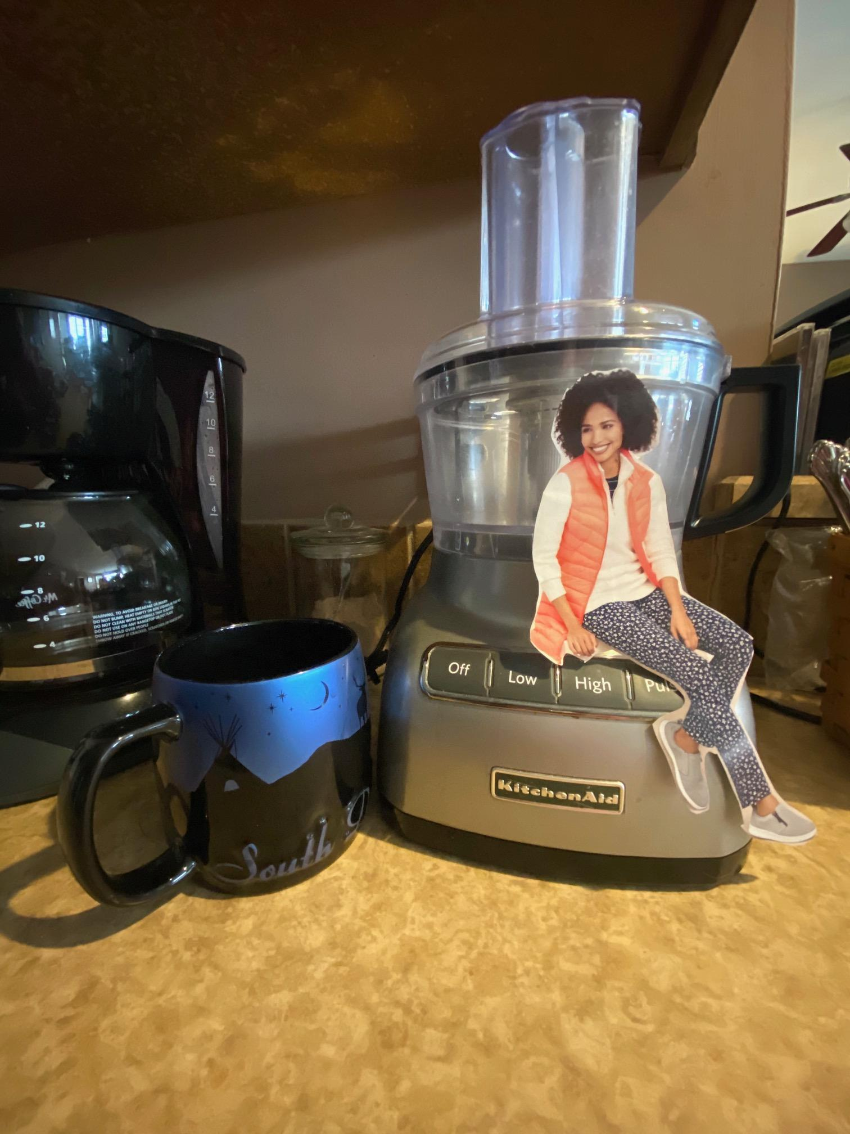
Examples of cut outs (photo cred. K.Campbell:

Slide 5
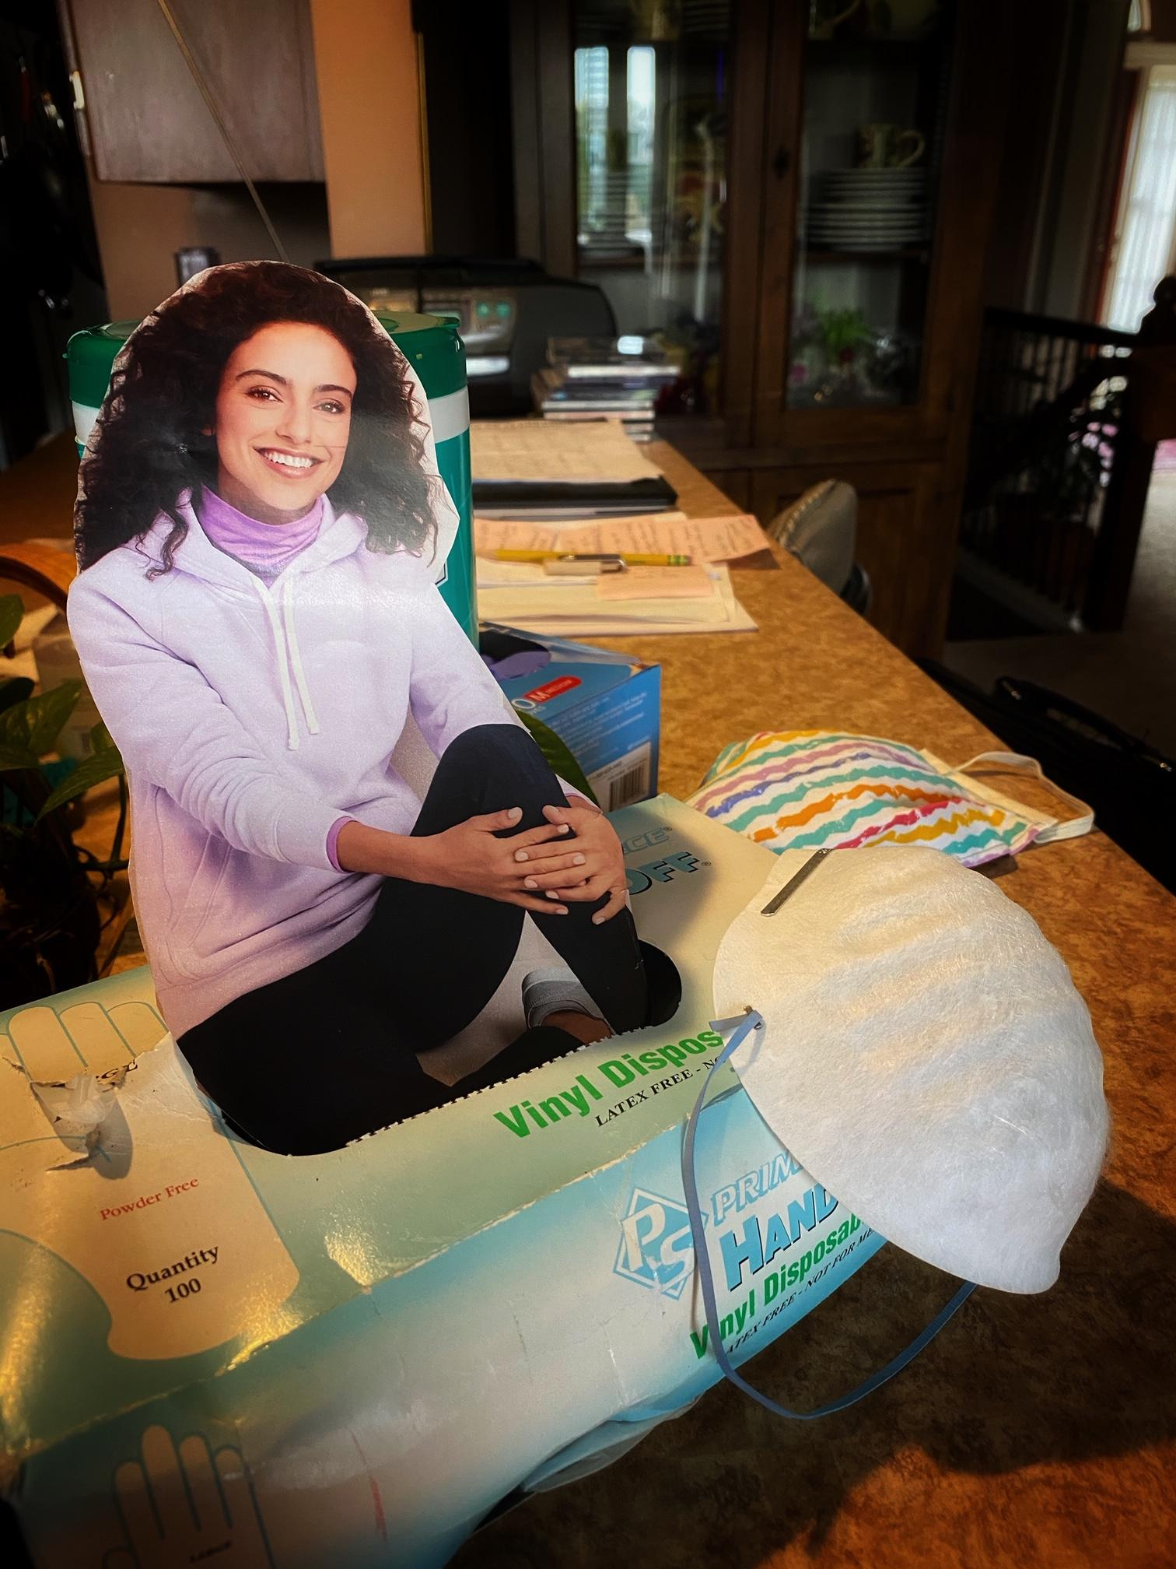
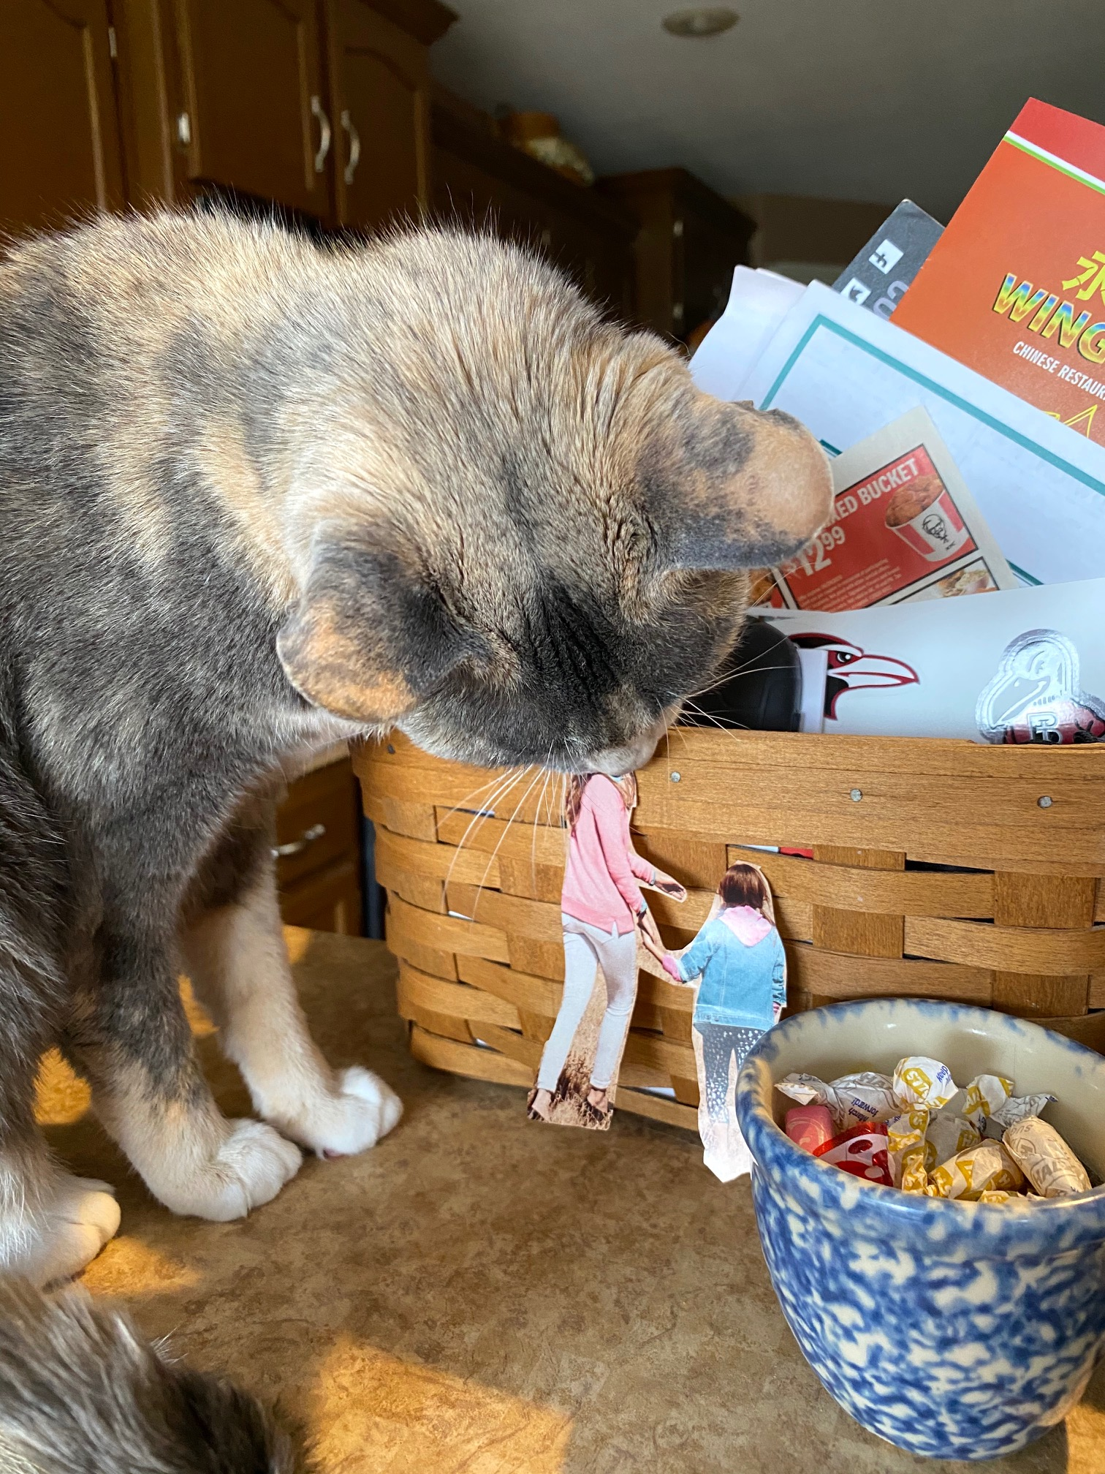
Continued examples with magazine cut outs with some humor. Photo credit K. Campbell (some edited in Snapseed).
No “REAL” people were eaten in this photo. LOL

